Slide 1
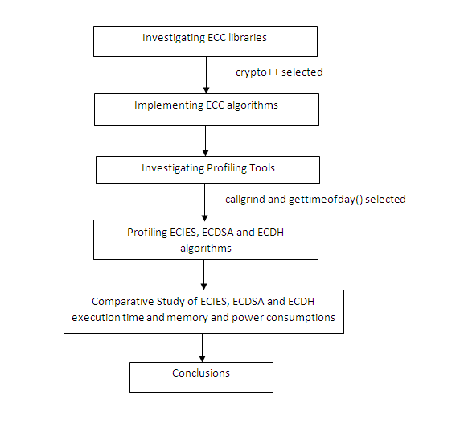
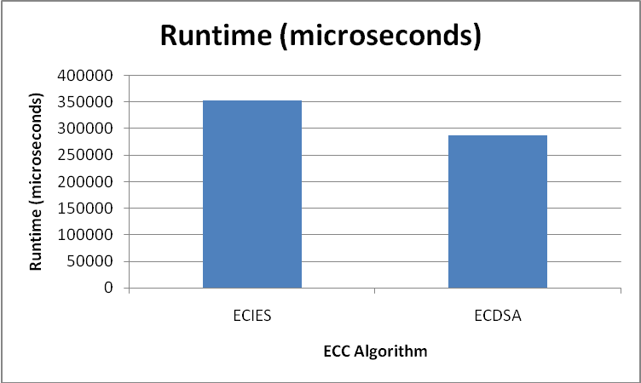
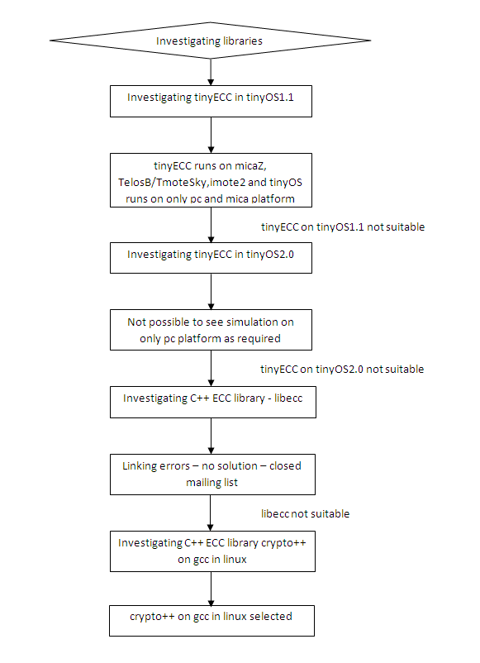
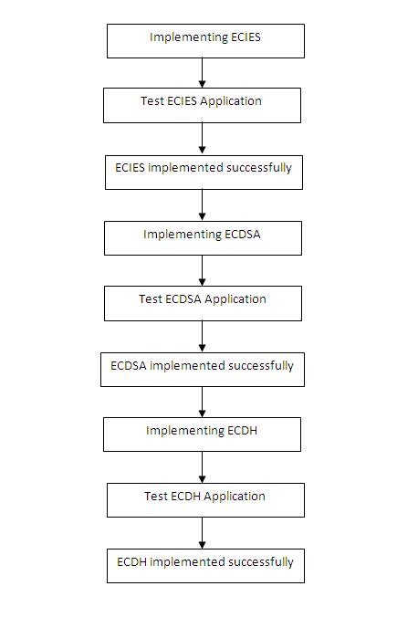
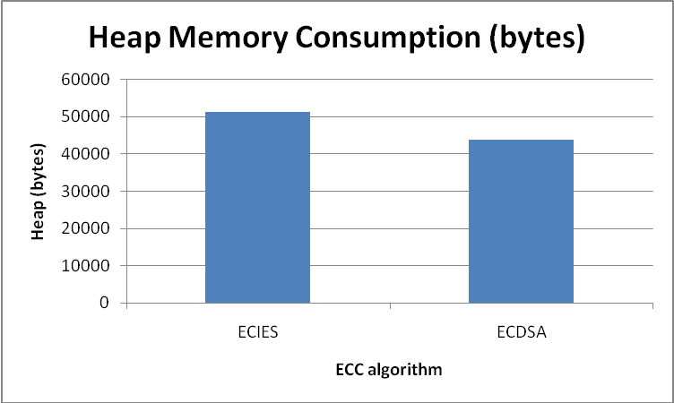
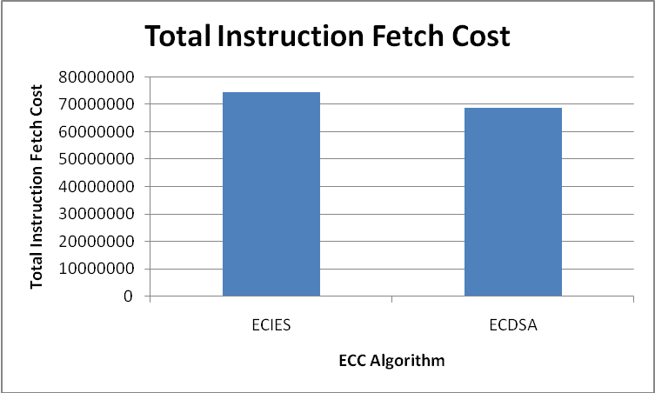
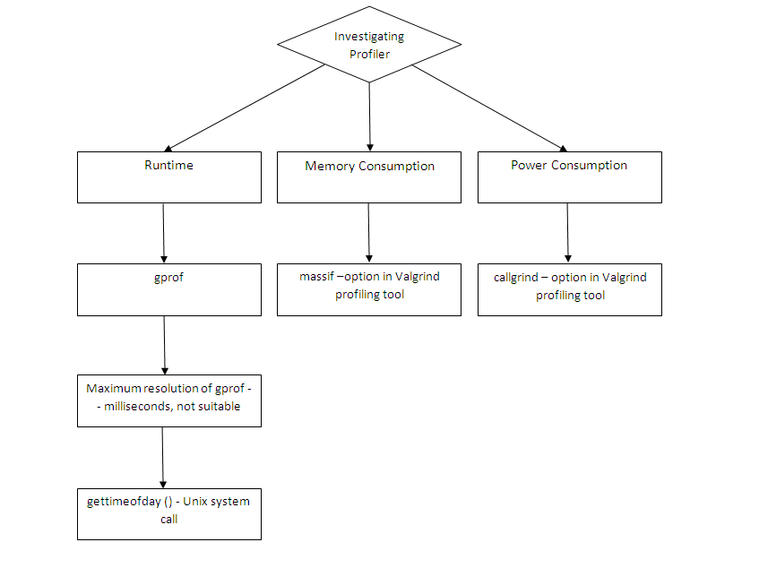
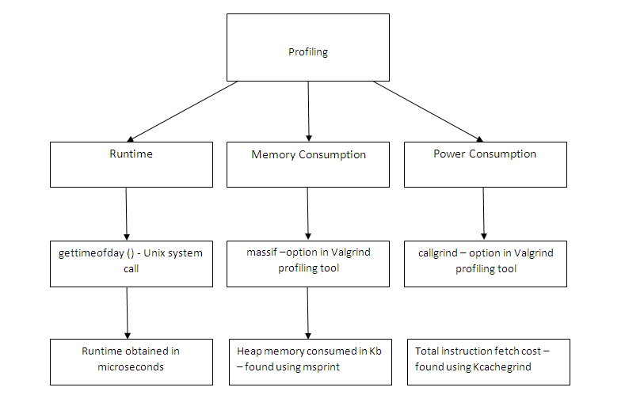
PROJECT – HOMOMORPHIC ENCRYPTION USING ECC
COMPUTER ENGINEERING DEPARTMENT
Anshika Mehndiratta, Bhavna Shivnani, A.V. Aruna
Guided by - Dr D.C. Jinwala
INTRODUCTION & OBJECTIVES
METHODOLGY OF EVALUATION
RESULTS & CONCLUSIONS
FUTURE WORK
A combination of symmetric and asymmetric encryption techniques are used to securely transmit the sensitive data over the insecure Internet. To perform any processing of such sensitive data without giving access to it requires the use of fully homomorphic encryption scheme, which requires heavy computation. This becomes a significant factor if are using resource constrained small portable devices. This gives rise to the need of Elliptic Curve Cryptography (ECC), which offers equivalent security with smaller key sizes, which can be computed with low resources.
Our project is to implement test programs of three ECC (Elliptic Curve Cryptography) algorithms: ECIES (Integrated Encryption Scheme), ECDSA (Digital Signature Algorithm), ECDH (Diffie Hellman) and do their profiling to perform a comparative study of their execution time and memory and power consumptions.
Algorithm | Runtime (microseconds)
ECIES | 352810
ECDSA | 287332
ECDH | 28027
Extending each of the ECC algorithms viz. ECDSA, ECIES and ECDH to include the complete set of security features i.e. Confidentiality, Integrity and Authentication
Improvement on the individual algorithms in terms of performance and memory. For instance implementing ECMQV Key Agreement and ECNR Signature Scheme, an improvement over ECDH and ECDSA respectively.
Using the improvised algorithms and their results for use in Wireless Sensor Networks, where ECC algorithms hold prime importance in providing security in a memory and power constrained environment.
Cross language implementation of ECC algorithms utilizing the capabilities and features of other languages like Java.
Improving the performance, integration cost and overhead of inter-processor communication for ECC algorithms.
Algorithm | Heap Memory Consumption (bytes)
ECIES | 51424
ECDSA | 43880
ECDH | 15680
UNDERLYING THEORY
REFERENCES
Homomorphic encryption
form of encryption
specific algebraic operation is performed on the plaintext another (possibly different) algebraic operation is performed on the ciphertext
decryption of result of algebraically processed ciphertext is same as that of the result of algebraically processed plaintext
helps to process data without compromising on the privacy of the data.
Wireless sensor network
large number of small, low-power, low-cost nodes
form a self-organized network using wireless peer-to-peer communication
Limitations
Energy
Memory
Transmission Range
Self-Organization
Fault Tolerance
Scalability
ECC (Elliptic Curve Cryptography)
public key cryptography
a set of predefined constants - ECC – Domain Parameters
known by all devices participating in communication
Mathematical operation - defined over Elliptic Curve
Advantages of ECC:
Small key size
160-bit key in ECC equivalent to 1024-bit key in RSA
Less resource consumption – processing power, memory & power
An Liu and Peng Ning, TinyECC: A Configurable Library for Elliptic Curve Cryptography in Wireless Sensor
Barry Doyle et al., Security Considerations and Key Negotiation Techniques for Power Constrained Sensor
Hai Yan and Zhijie Jerry Shi, Studying Software Implementations of Elliptic Curve
Craig Gentry, Computing Arbitary Functions of Encrypted Data in Communications of the ACM
Anoop MS, Elliptic Curve Cryptography, An Implementation Guide, January 2007
http://en.wikipedia.org/wiki/Elliptic_curve_cryptography
http://en.wikipedia.org/wiki/Crypto%2B%2B
http://en.wikipedia.org/wiki/ECIES
http://en.wikipedia.org/wiki/Profiling_%28computer_programming%29
http://linux.die.net/man/3/gettimeofday
http://valgrind.org
http://valgrind.org/info/tools.html
Algorithm | Total Instruction Fetch Cost
ECIES | 747 138 248
ECDSA | 688 745 567
ECDH | 52 746 600
Conclusion & their utility in application
In time, memory and power constrained applications, and where authentication is of prime importance for e.g. cellular telephony, access control applications like web-based result, ATMs, physical entry to restricted areas or border crossings, ECDSA should be preferred over ECIES.
In applications where secrecy of communication is of prime importance, in comparison to time, memory and power consumed, for e.g. PIN no., credit card no. , defence communications, ECIES should be preferred.
RELATED WORK
Earlier Researches
TinyECC library on TinyOS
Mote based simulation and conclusion
Processor-based profilers
ECC operations & EEA algorithm profiled
Implementation and profiling on different word size processors
Our Work
CryptoPP library(C++)
Implementation of real world application
Linux based profiler
ECIES,ECDSA & ECDH profiled
Implementation and profiling different algorithms on same hardware

